Slide 1

TRANSITIONS

Slide 2
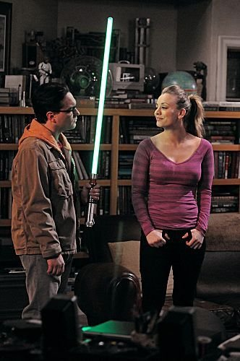
Q. How could this be improved?
Leonard and Sheldon were roommates. Leonard was lonely. Penny moved in. Leonard fell in love with her. She initially rejected him. They eventually started dating. They broke up. They started dating again. Leonard proposed to Penny. She accepted.

Slide 3
A. Add transitions
Leonard and Sheldon were roommates, but Leonard was lonely. However, when Penny moved in, Leonard fell in love with her. Though she initially rejected him, they eventually started dating. After a while , they broke up. However, they started dating again soon after. When Leonard proposed to Penny, she accepted.
but
However
when
Though
After a while
However
soon after
When

Slide 4
What are transitional expressions?
Words or phrases that establish logical connections between words, phrases, sentences and paragraphs.

Slide 5
Overview
Purpose
Categories
Functions
Alternatives

Slide 6
Purpose

Slide 7
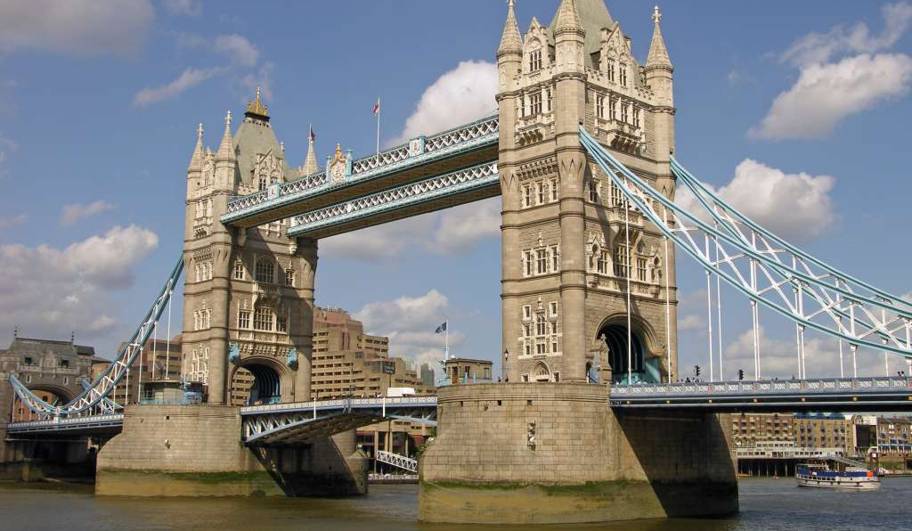
What do transitions do?
They act as bridges from one idea to another.

Slide 8
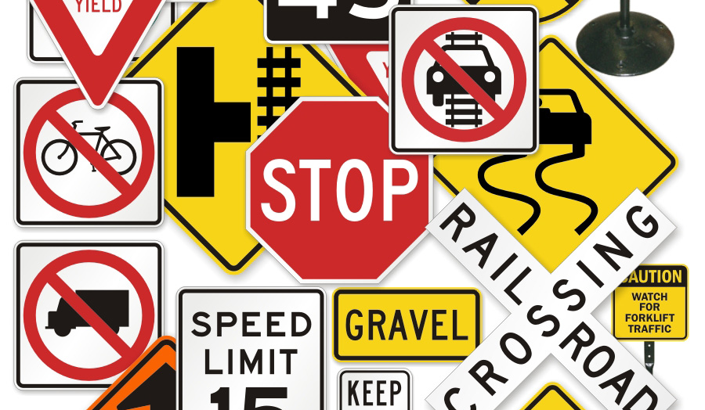
What do transitions do?
They act as signposts that show readers how ideas relate to each other.

Slide 9
Categories

Slide 10
Categories
Adverbial words/phrases
Prepositions/Prepositional phrases
Conjunctions

Slide 11
Adverbial phrases
Adverbial words/phrases are words or group of words that modify verbs, adjectives, or adverbs.
As transition words, they typically apply to verbs.
They often introduce a sentence.

Slide 12
Adverbial Words
These often appear at the beginning of a sentence and are closed off with a comma.
Examples
However
Therefore
Additionally
Moreover
Besides

Slide 13
Adverbial Phrases
Often appear at the beginning of the sentence.
Usually start with a preposition.
When opening a sentence, they are closed out with a comma.
Examples
In the 18th century,
During the evening,
At the library,
With regard to education,

Slide 14
Prepositions and Prepositional Phrases
A preposition comes before (pre) a noun/pronoun
Highlights an objects position to another noun
May be a phrase that starts with a preposition

Slide 15
Prepositions
Prepositional Phrases
In
On
At
Of
For
From
To
Over
During World War II,
In May of 1941,
On November 11th, 1918,
For a variety of reasons,

Slide 16
Conjunctions
Coordinating
Subordinating
Correlating

Slide 17

Coordinators: Examples
F For (explains why)
A And (addition)
N Nor (excludes)
B But (disagree/contrast)
O Or (alternative)
Y Yet (disagree/contrast)
S So (consequence)

Slide 18
Subordinating
Preceding
Concluding

Slide 19
Preceding: Introduce a clause
Concluding:
Follow a clause
If you need space, you should join NASA.
Because I took a day off, I got fired from the calendar factory.
If an evening dress is eveningwear, a suit of armor must be silver ware.
The skeleton didn’t go to the dance because he had nobody to dance with.
Why do they put a light in the fridge if we shouldn’t eat at night?
The golfer needs new socks because he has a hole in one.

Slide 20
Correlating Conjunctions
Correlating conjunctions links pairs of words within a sentence and frames them as equally important.
either... or
neither... nor
whether... or
just as... so
as... as
as much... as
no sooner... than

Slide 21
Functions

Slide 22
Functions
Temporal Relationships
Spatial Relationships
Logical Relationships

Slide 23
Temporal Relationships
Sequential
Before
During
After

Slide 24
Sequential
first/firstly, for example/instance
second, thirdly, fourthly, ect.
Then, soon, later, during, meanwhile, subsequently, immediately, at length, eventually, in the future, currently
Last/Lastly, Finally,

Slide 25
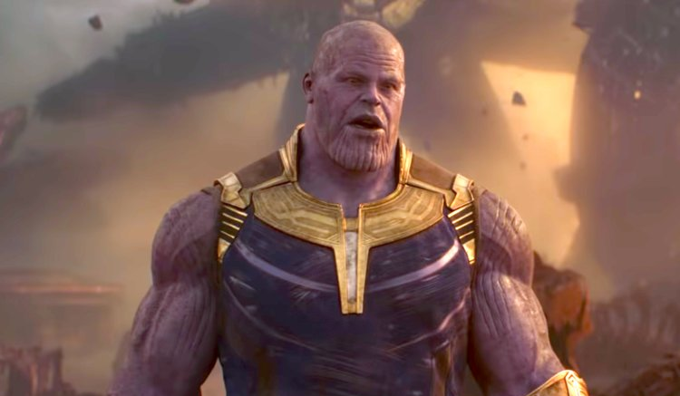
Example
First Thanos collected the Infinity Stones, then he wiped out half the universe. Now he is enjoying his retirement.

Slide 26
Before
Before
Prior to
Leading up to
In advance of
Ahead of
Preciding
By

Slide 27
During
While
As
Since
At the same time as
During
Meanwhile
All the while

Slide 28
After
After
Afterwards
Later
Then
Next
Subsequently
After a while

Slide 29
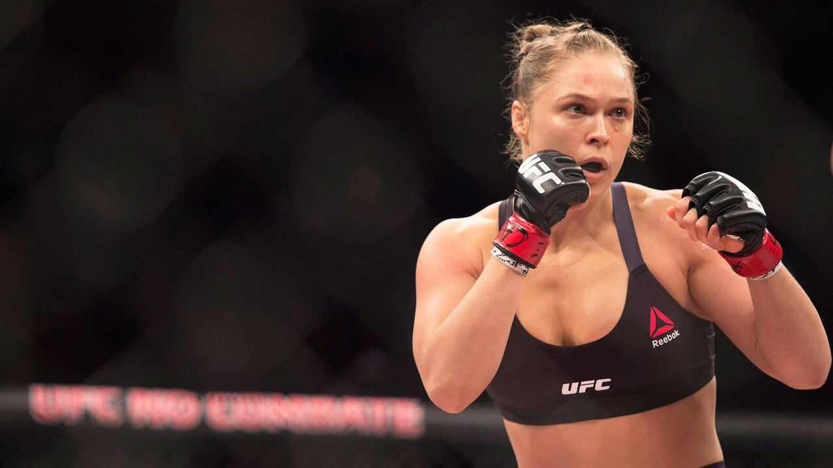
Example
Prior to joining the UFC, Ronda Rousey competed in the 2008 Olympics. After joining the UFC, she become the first female UFC champion. During her UFC career, she began acting. Now she is a WWE superstar!

Slide 30
Spatial Relationships
Above
Below
Beside
Other

Slide 31
Above
Above
Over
Overhead
Beyond
On top of

Slide 32
Below
Below
Under
Beneath
Underneath

Slide 33
Beside
Beside
Next to
Alongside
Side by side
Side by each
Adjacent to

Slide 34
Others
Behind
Before
In front of
In
Within
Without
Outside of

Slide 35
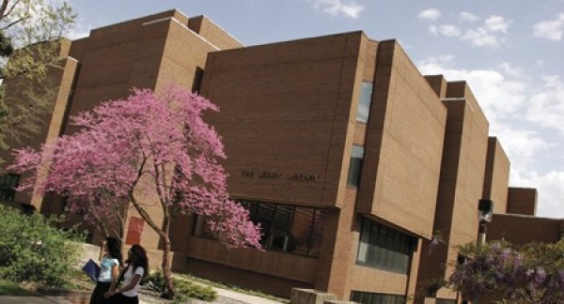
Example
The Writing Support Desk is in Leddy Library, on the first floor and adjacent to the Circulation Desk. Below the desk is Leddy’s lower level, and above is the library's collection of books.

Slide 36
Logical Relationships
Example/Addition
Compare/Contrast
Cause/Conclusion
Concession

Slide 37
Logical Transitions: Addition
In addition
Additionally
Furthermore
Moreover
Likewise
Also
And
Lastly/Finally

Slide 38

Example
There are several reasons why Michonne should stay. For example, she is great with a sword. In addition, she is brave. Lastly, I’m too scared to tell her to leave.

Slide 39
Logical Transitions: Comparison
Similarly
Likewise
In the same way
Equally
Correspondingly

Slide 40
Example
Julian Assange created WikiLeaks. Likewise, Chewbacca created WookieLeaks.

Slide 41
Logical Transitions: Contrast
In contrast
However
Though/Although
But
Conversely
Alternately

Slide 42

Example
A comma is a pause at the end of a clause. In contrast, cats have claws at the end of their paws.

Slide 43
Logical Transitions: Concession
Of course
To be sure
Certainly
Naturally
Granted
Still
That Said

Slide 44
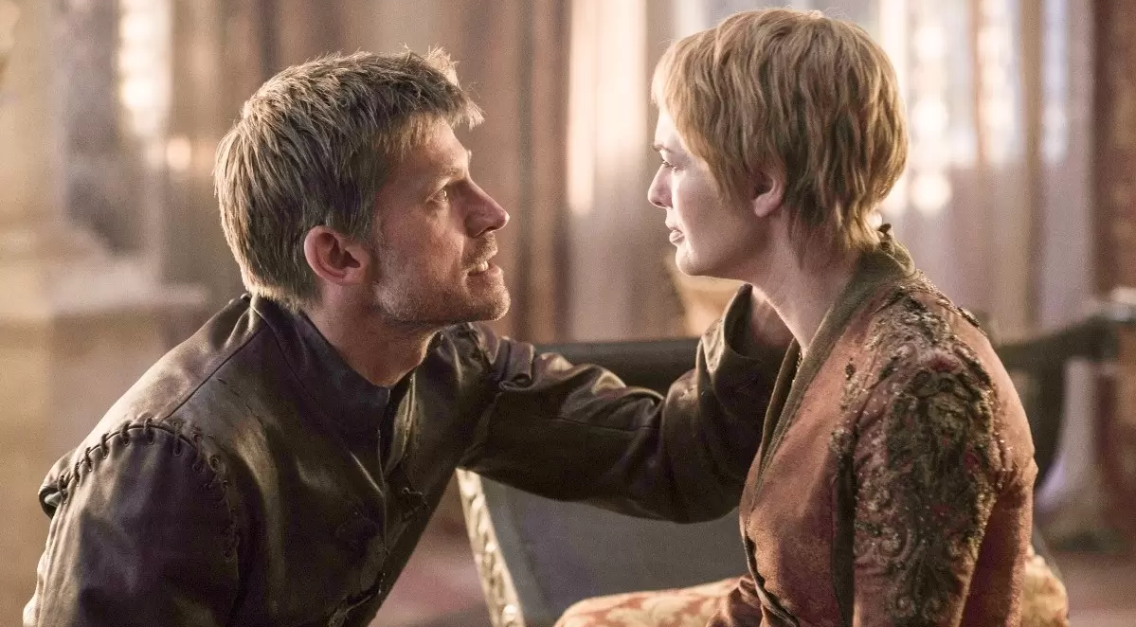
Example
Of course I love you; you’re family!

Slide 45
Logical Transitions: Cause
Therefore
Thus
Consequently
So
Accordingly
Due to
Hence
As a result
Because

Slide 46
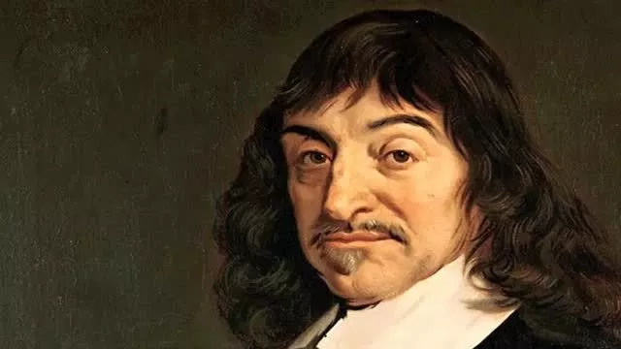
Example
René Descartes says, “I think; therefore, I am!”

Slide 47

Example
Donald Trump says, “I tweet; therefore, I am!”

Slide 48
Logical Transitions: Cause
In conclusion
To conclude
In summation
To finish
In closing

Slide 49
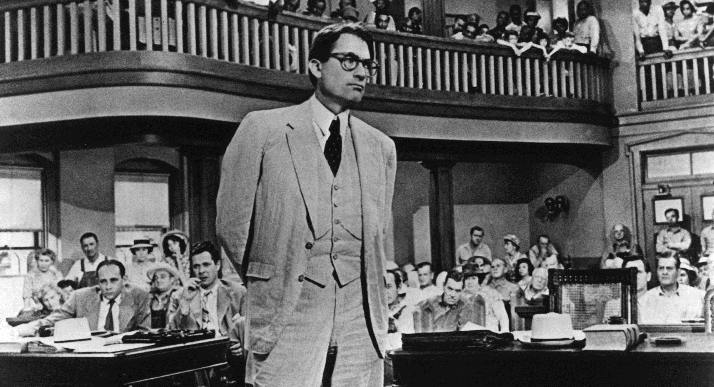
Example
“In closing, I am confident that you gentlemen will review, without passion, the evidence that you have heard.”
Atticus Finch

Slide 50
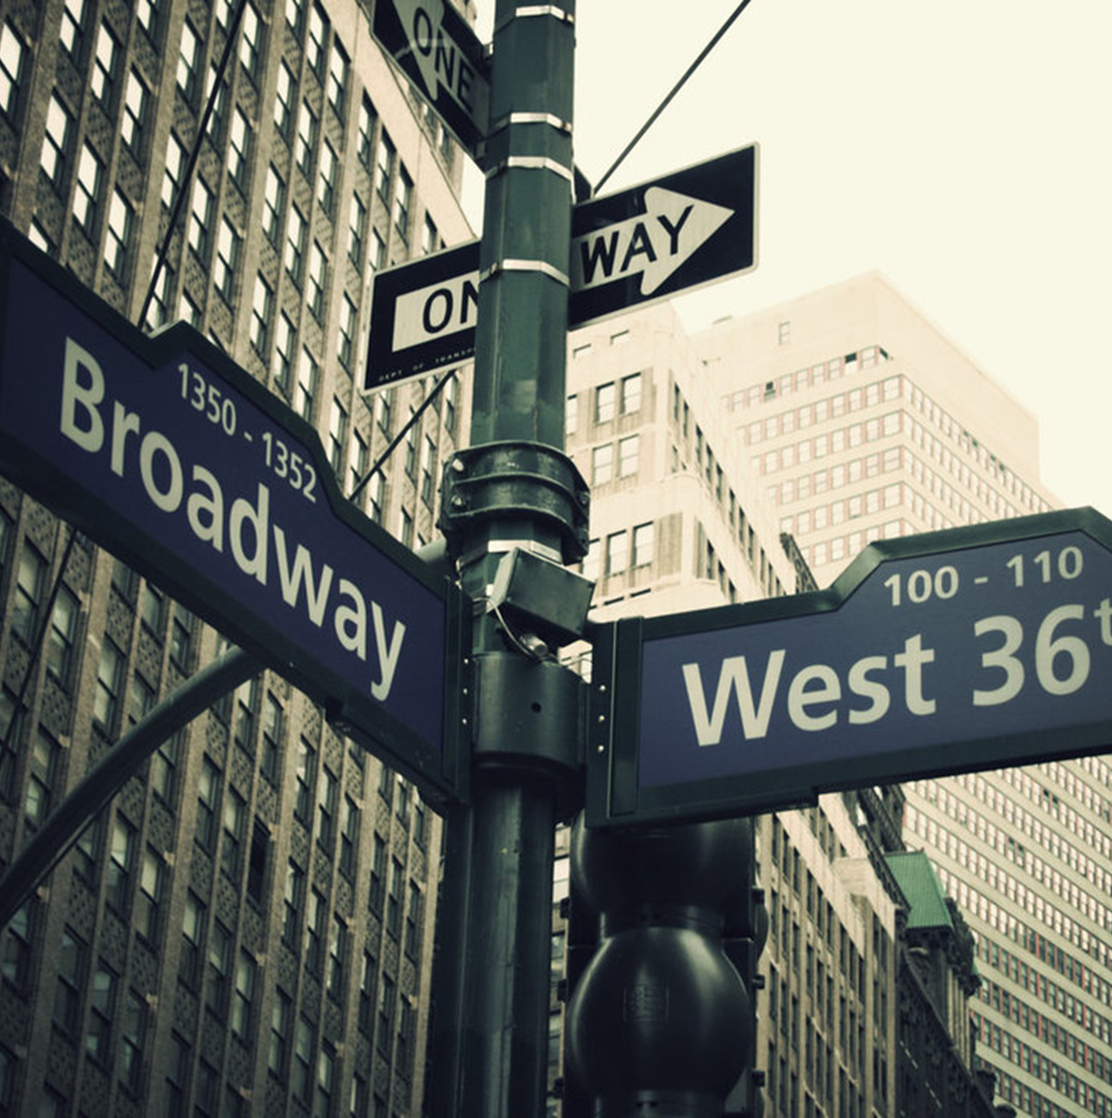
…and many, many more.
Still looking for more? Find an even more comprehensive list here.

Slide 51
Alternatives

Slide 52
Problems with transitions
Increased word count
Repetitive structure/language
Formulaic writing

Slide 53
Can ideas be connected without using transitional expressions?
Repeat
Repeat a word or phrase from a previous sentence or paragraph
Use
Use pronouns that refers to a noun/phrase used previously
Pair
Pair associated/binary word combinations
Add
Add punctuation

Slide 54

Repetition
This creates a chorus that aligns text.
This approach is more common when speaking

Slide 55
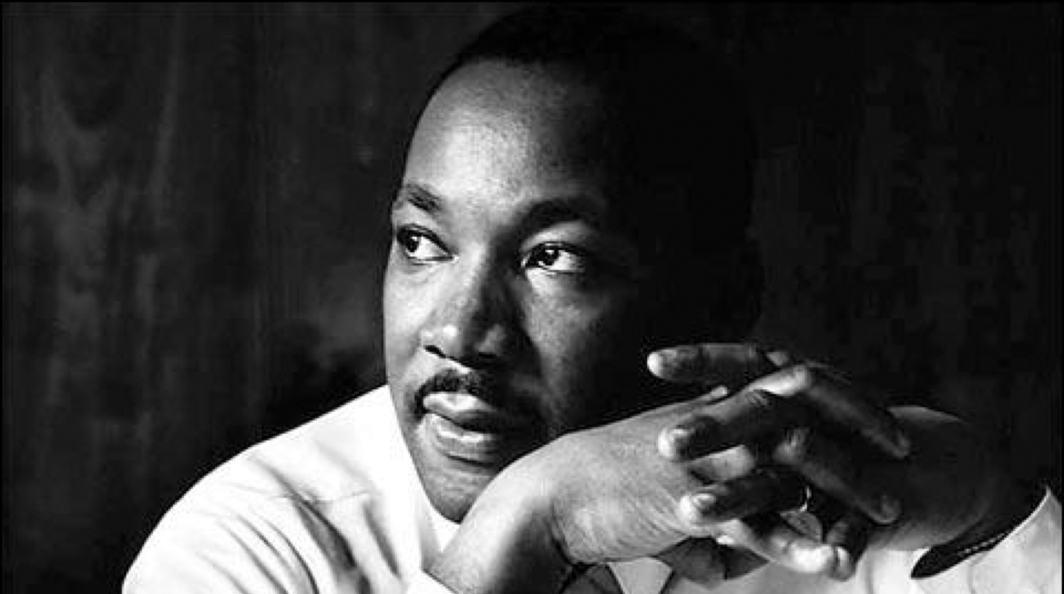
Example
Martin Luther King Jr.
“I have a dream.”
“We shall overcome.”

Slide 56
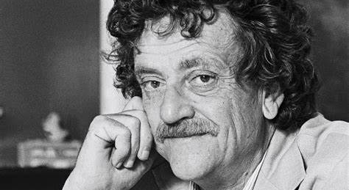
Example
Kurt Vonnegut
“So it goes…”

Slide 57
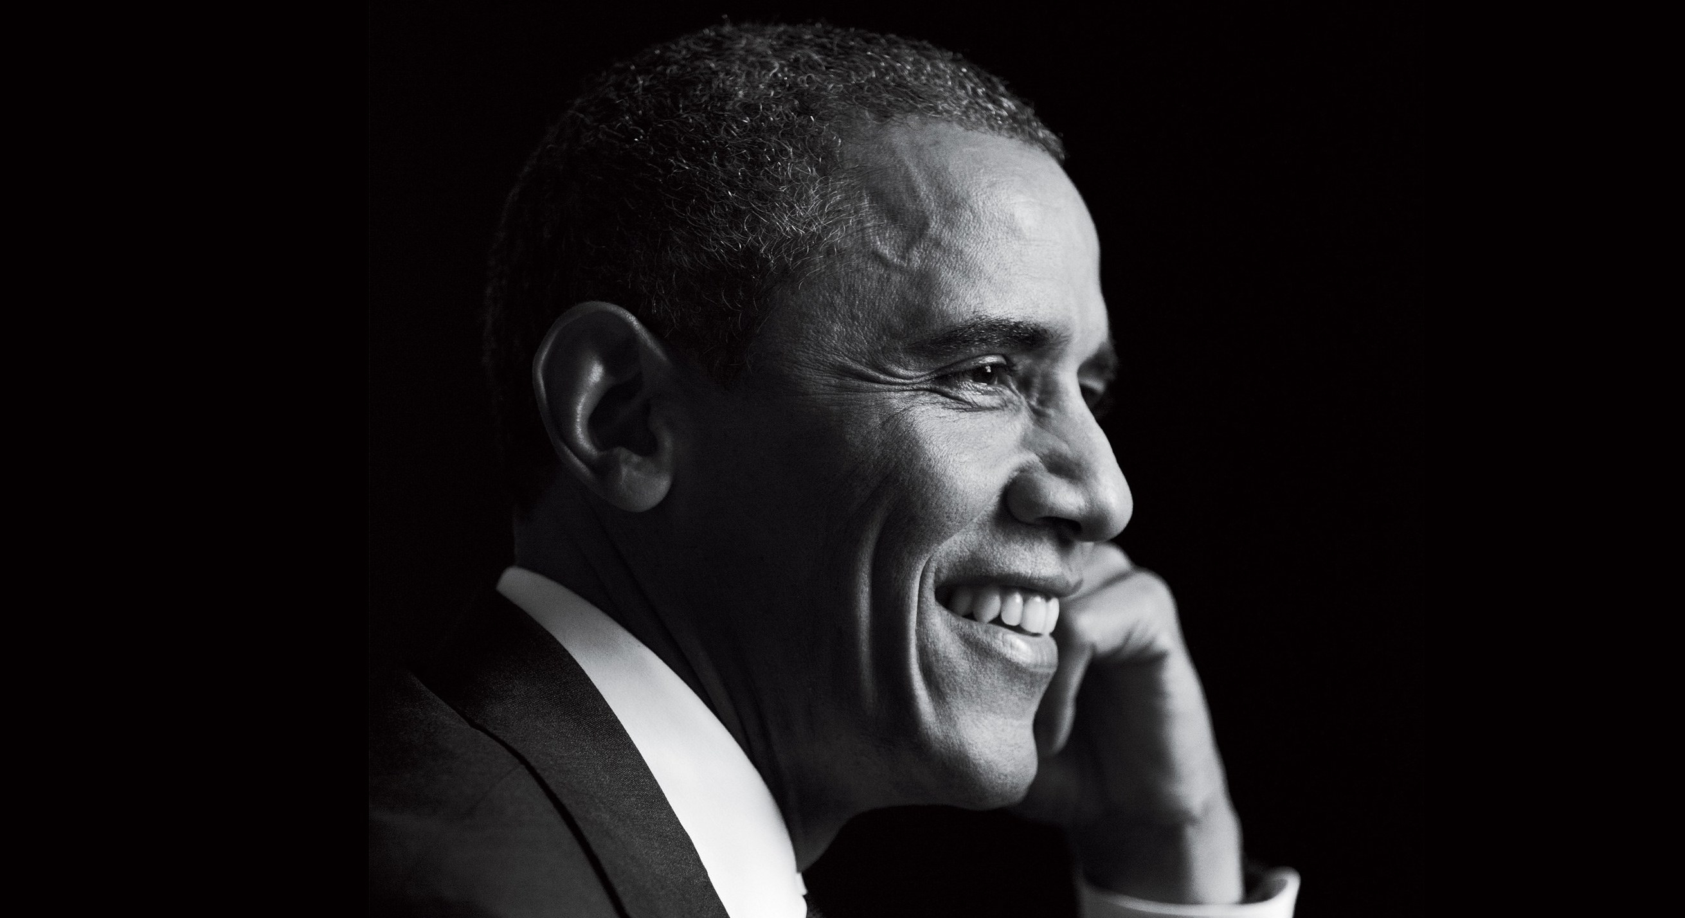
Example
Barack Obama
“Yes we can.”

Slide 58
Pronouns
This
They
Them
She
When used effectively, pronouns can call back to the ideas, peoples, and things recently discussed and link them to new ideas.
Her
That
It
He
Who
Whom
Him

Slide 59
Example
After Catwoman rescued Batman, he tried to arrest her. That was the last time she would ever help him.

Slide 60

Pairing Words
Pairs words associated with each other helps to created implied relationships.
This is especially effective with binary terms.

Slide 61
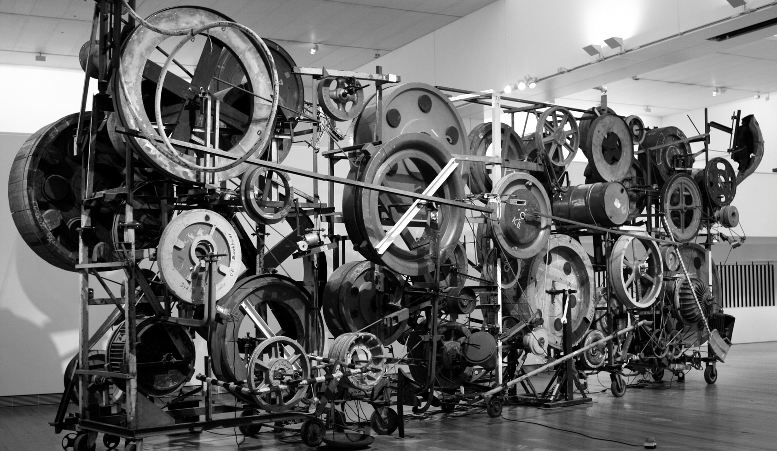
Example
The machine has a minimum output of 500 units per week. The maximum output is one million units.

Slide 62
Punctuation
;
Punctuation can guide the reader and show the relationships between clauses, phrases, and words.
Colons and introduce lists, conclusions, and summaries
Semicolons can tell the reader to infer a relationship.

Slide 63
Example
Sheldon’s not here; there is a train exhibit down town.

Slide 64

Example
I examined the evidence: everybody participated in the murder!

Slide 65


Slide 66

Exercise
Mad Libs

Slide 67
Overview
Category
Purpose
Alternatives
Adverbs
Conjunctions
Preposition
Temporal
Spatial
Logical
Repetition
Pairing/binaries
Pronouns
Punctation

Slide 68


Slide 69
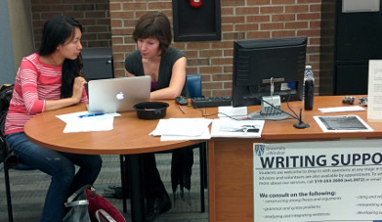
Still Have Citation Questions?
If you more individualized support, visit us at the Writing Support Desk in Leddy Library!

